Slide 1

Review 3 - Advances in Data Engineering
Presentaion by:
Sai Sakthi DR - 22MID0209
M. Meera Dharshini - 22MID0205

Slide 2
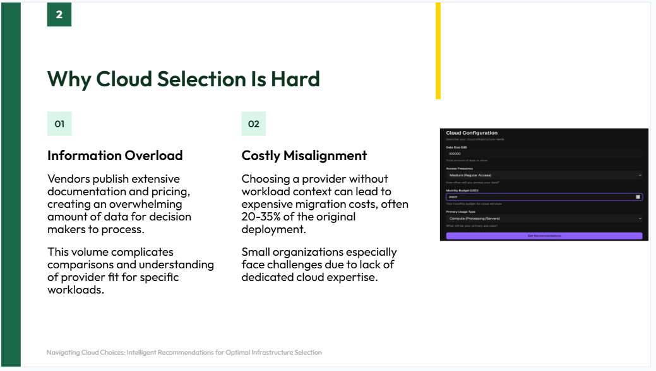

Slide 3
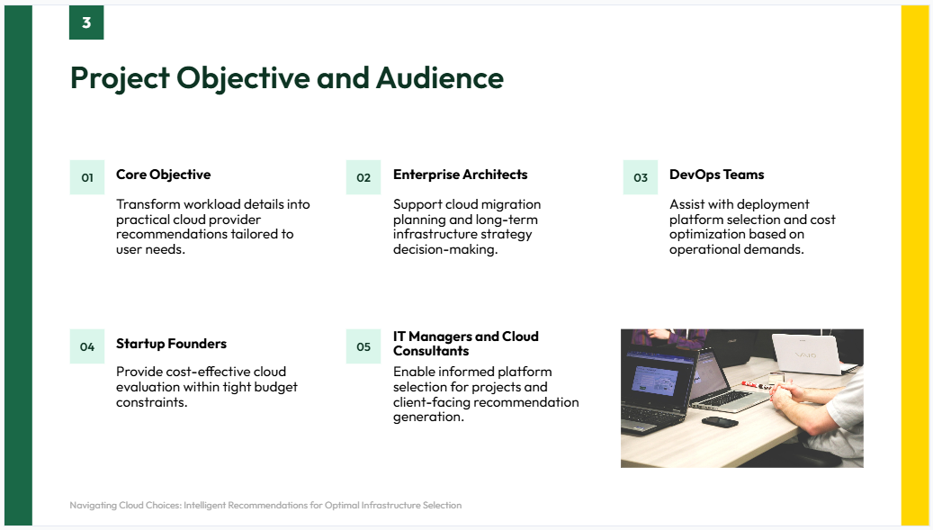

Slide 4
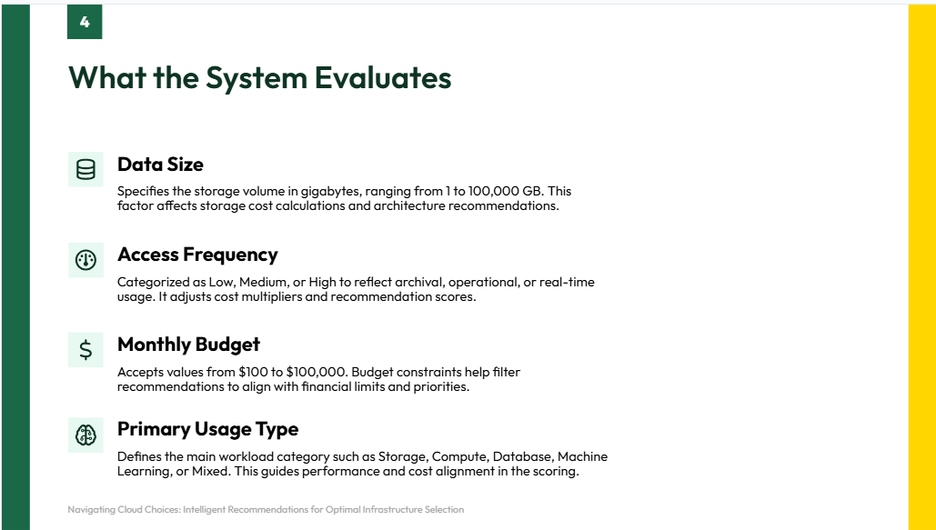

Slide 5
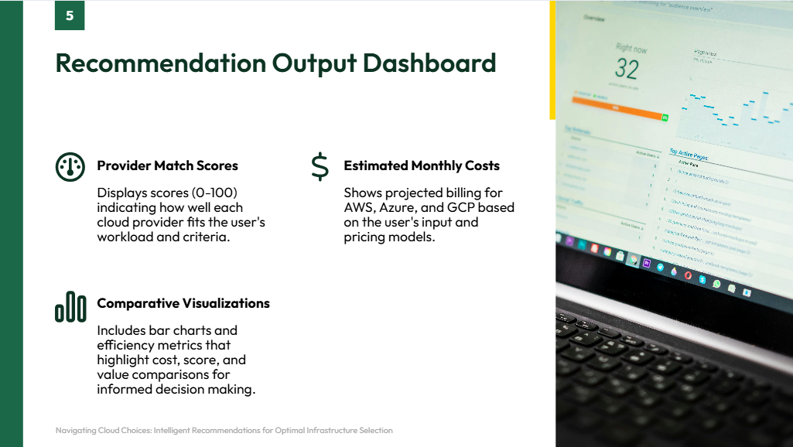

Slide 6
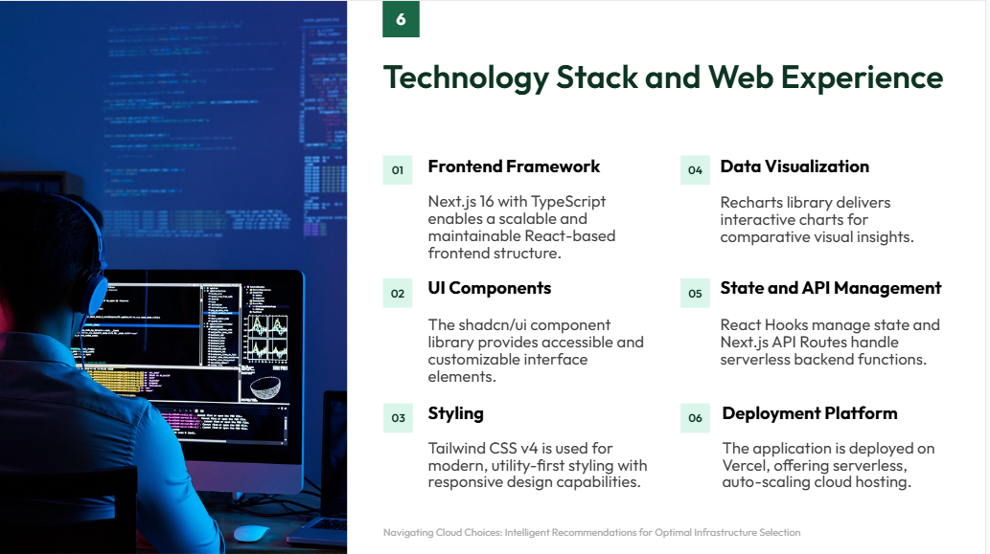

Slide 7
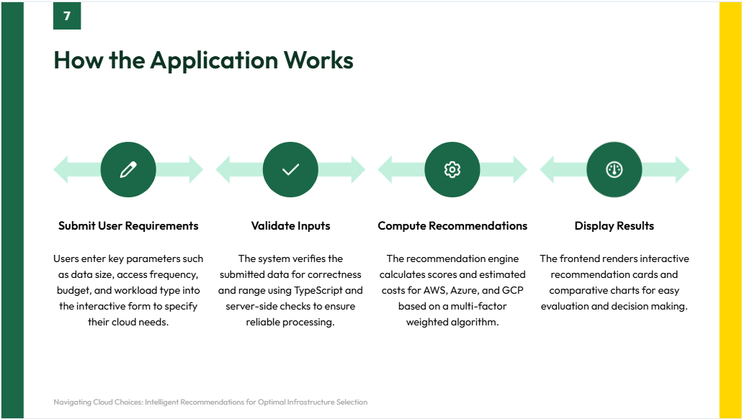

Slide 8
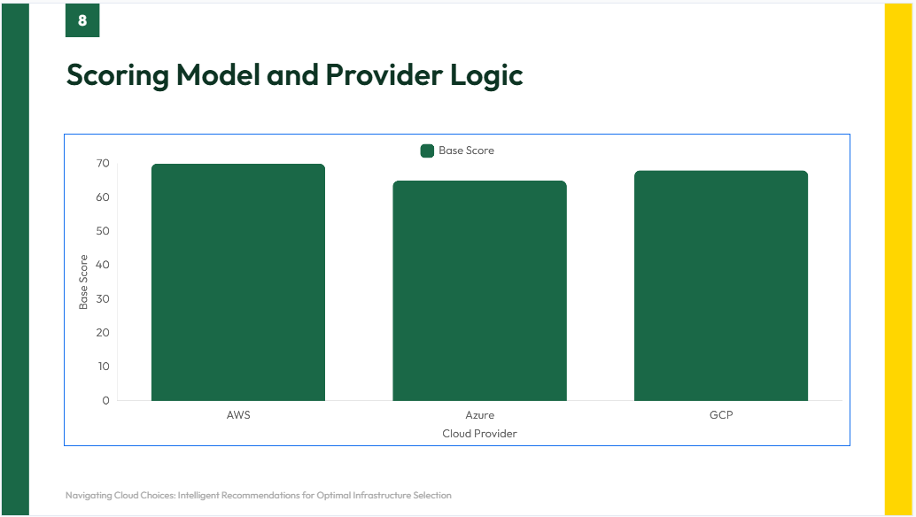

Slide 9
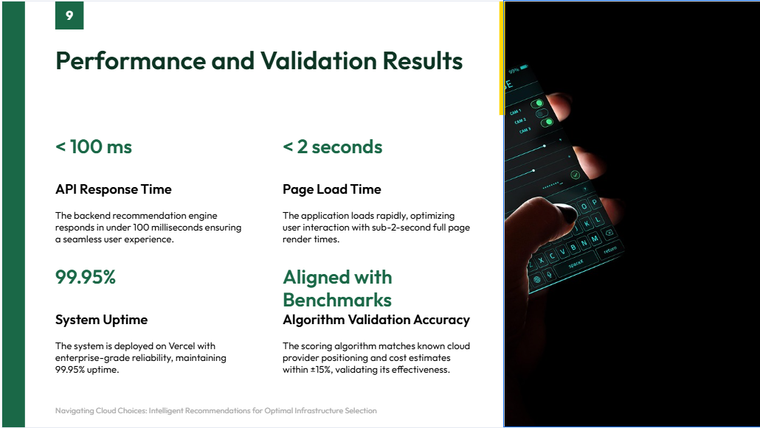

Slide 10
